Slide 1

TANZANIA WATERPOINTS ANALYSIS AND SOLUTIONS.
Predicting the functionality of water wells in Tanzania using
machine learning.

Slide 2





Problem
statement
Background
of study
objectives
findings
Model
overview

Slide 3
PROBLEM STATEMENT
The Ministry of Water in Tanzania needs to ensure that clean,
potable water is available to Tanzania's inhabitants.
The water problem can be easily solved with knowledge of the
functionality of the different waterpoints.
Classifying the functionality of a wter point to be either
functional, functional but needs repair or non functional,
assist the government know the waterpoints that either need
improvement, or those that are functional.
If we can accurately classify a waterpoint, the Ministry will
have a better understanding of their existing infrastructure,
and because of cost savings, will be able to reallocate existing resources to expand the water infrastructure.

Slide 4
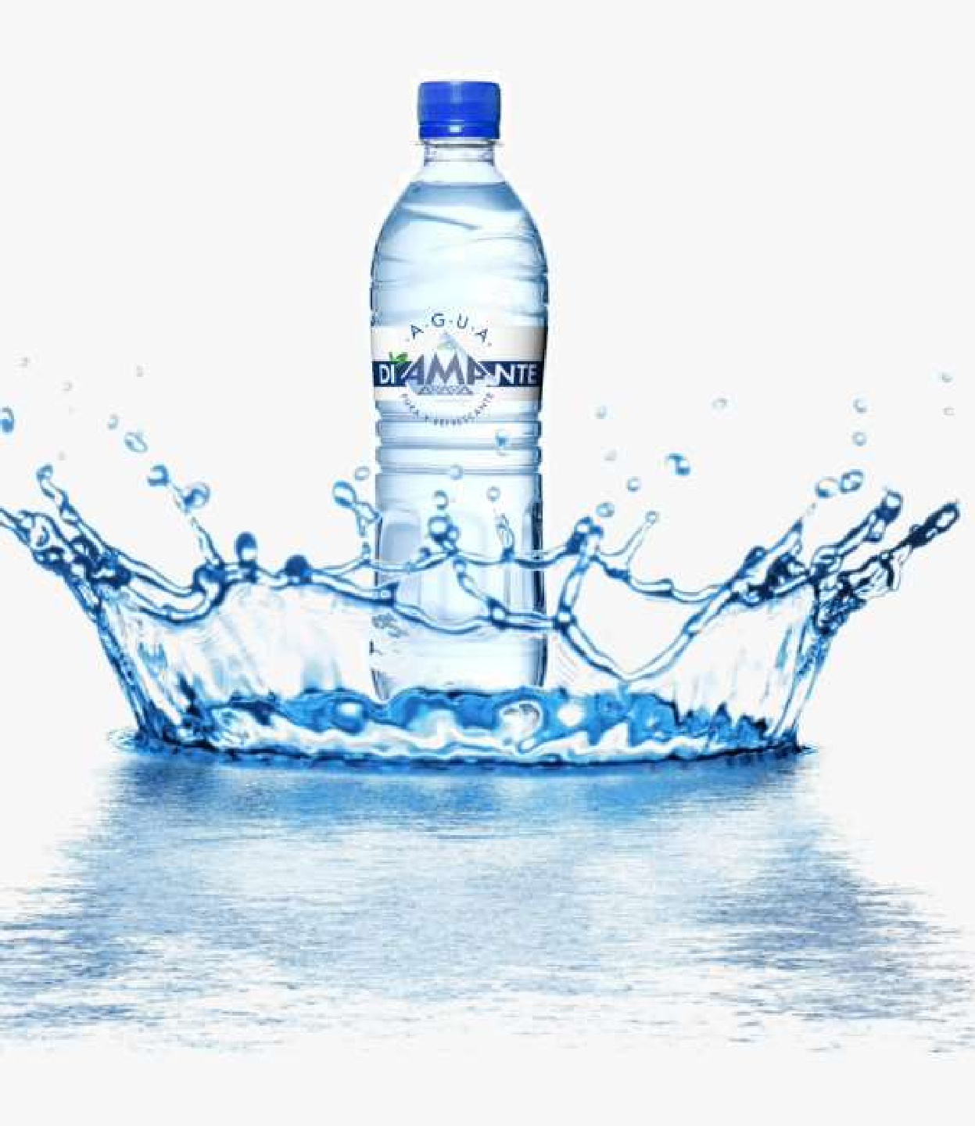
BACKGROUND OF STUDY
Poverty Rate in Tanzania
14 billion inhabitants of Tanzania live under extreme poverty conditions with an average of $ 1.9 dollar living expenditure per day
Clean water requirement and sanitisation
4 million people in Tanzania lack access to an improved source of
safe water, and 29 million don't have access to improved sanitation.
It is estimated that Tanzania spends 70 per cent of its health budget on preventable WASH-related diseases as the majority of the population does not have access to improved sanitation, and close to half of the population does not have access to clean drinking water

Slide 5

ULTIMATE OBJECTIVE
Create solutions to the water crisis problem by predicting the functionality of the water pumps whether they are functional, needs repair or completely non-functional.

Slide 6
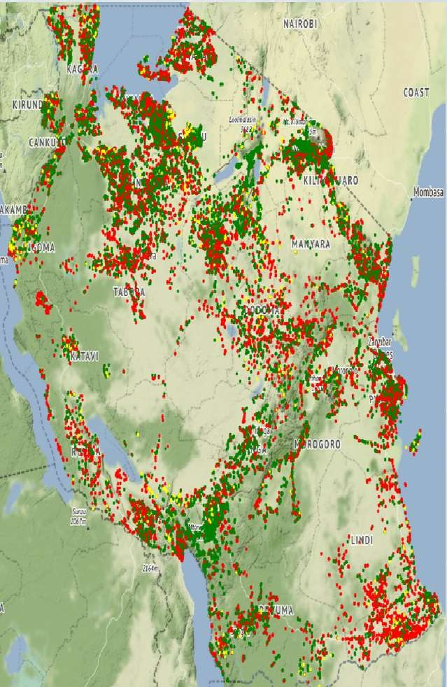

RESEARCH FINDINGS
More than 60000 thousand wells are
distributed within Tanzania.
Functional water wells
Functional but needs repair
Non functional
Using the Taarifa dataset features, the functionality of the water points can be predicted.

Slide 7
INSIGHTS
Important prediction features from the Taarifa dataset

Slide 8
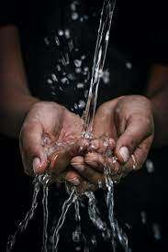
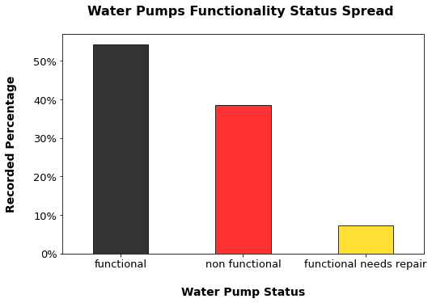
FUNCTIONALITY DISTRIBUTION
DISTRIBUTION TARGET VARIABLE
WATER SOURCE TYPE
Functional water points from more than 50 % of the
waterpoints.
Waterpoints that need repair though are still functional form
less than 10%.
Non functional water points are more than 35% of the waterpoints.

Slide 9

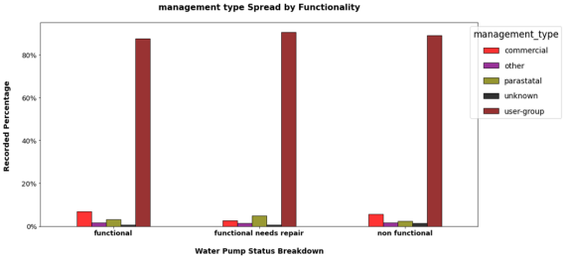
WATERPOINT MANAGEMENT
MANAGEMENT DISTRIBUTION BY
FUNCTIONALITY
More than 80 percent of the waterpoints are managed
commercially.
The highest category of the functional, non-functional
waterwalls are managed commercially.

Slide 10

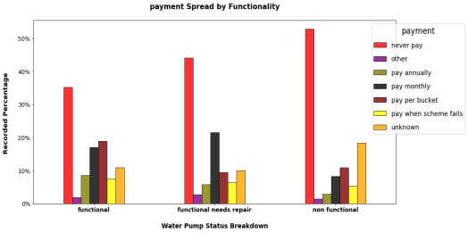
PAYMENT TYPE
PAYMENT TYPE AND FUNCTIONALITY
More than 50 percent of the non functional water points
are not paid for.
The least percentage of non functional water points are paid for per bucket(clear illustration of the poverty in Tanzania)

Slide 11
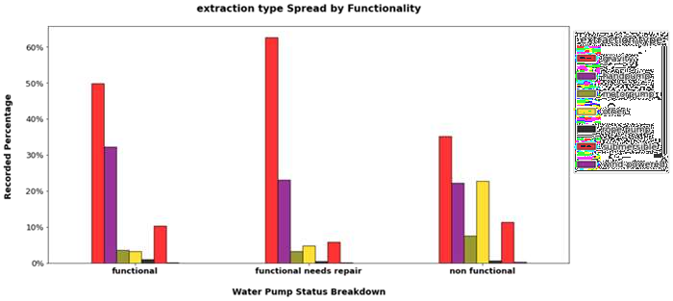
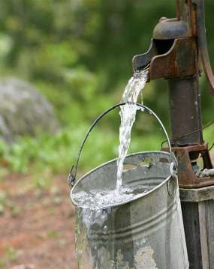
EXTRACTION TYPE
DISTRIBUTION OF EXTRACTION TYPE WITH FUNCTIONALITY
WATER SOURCE TYPE
Gravity is the most common type of extraction.
Has the highest percentage of waterpoints that need repair.

Slide 12

RECOMMENDATIONS
targeting repairs to clusters of wells especially those with high populations
payments of some kind will provide an incentive to keep wells functional
allocate funds and resources to effective organizations with a track record
Use the model to prioritize site visits. Priority should be given to maintenance staff sent to waterpoints that are predicted to be functional but in need of repair or are non functional.
The ministry can use the analysis as a tool to choose installer with the most
long lasting pumps by looking at the age of the well and its fuctionality.
By looking at the predicted values, the ministry can figure out the management group with the highest functional pumps and extraction type that when used are the most functional
The Ministry can use the accuracy of the model and its improved maintenance program as a selling point when soliciting international aid.
•

Slide 13

MACHINE LEARNING MODEL
The cross validation score for this model is 89%. This score shows that the performance of the model is standard since it can be able to predict 89% of the test data.
log loss: 0.4106744518960779
accuracy: 0.8078563411896745
precision: 0.7956785443517816
recall: 0.8687913907284768

Slide 14

FUTURE IMPROVEMENTS
Incorporate other factors like the climatic
conditions
Update model regularly for maintenance
purposes.

Slide 15
THANK YOU

Slide 16

QUESTIONS
Questions?

